Slide 1
Cloud Computing and Big Data Cloud and Big Data Pulling it all together
Oxford University
Software Engineering Programme
July 2021

Slide 2
Contents
Understanding the bigger picture
What are the different components
Message queueing and collection systems
Map-Reduce and DAG systems
Realtime Systems
Theory recap

Slide 3
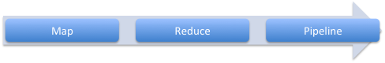
The big picture
Visualisation System
NoSQL or SQL database
Visualisation Store
DAG pipeline Map-Reduce Micro-batch etc
Realtime
Master data
Storage
Data collection models, queueing
The World

Slide 4
The big picture
You have immutable master data
You create a set of processes to:
Collect that data
Store master data
Process data
Store aggregates
Visualise and present
Some of those processes act on batch and others on real-time data

Slide 5
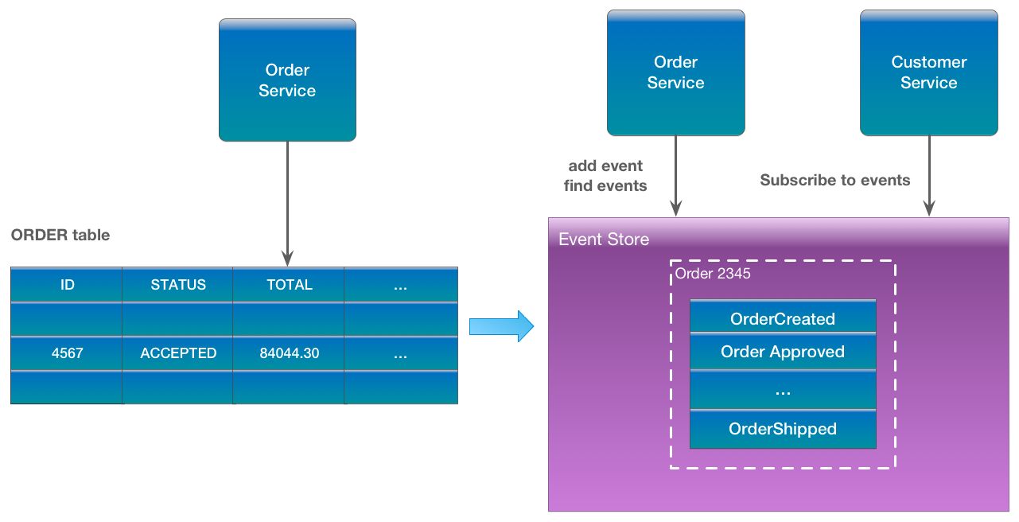
Event Sourcing
https://eventuate.io/whyeventsourcing.html

Slide 6


Lambda vs Kappa

Slide 7
How to choose the components?
Two main approaches:
Best of breed
Choose the best available component in each space
Stack
Choose a curated stack that a team or organization is providing/selling/supporting

Slide 8
Approach
Minimise the pain
Choose what you need when you need it
Don’t over engineer

Slide 9
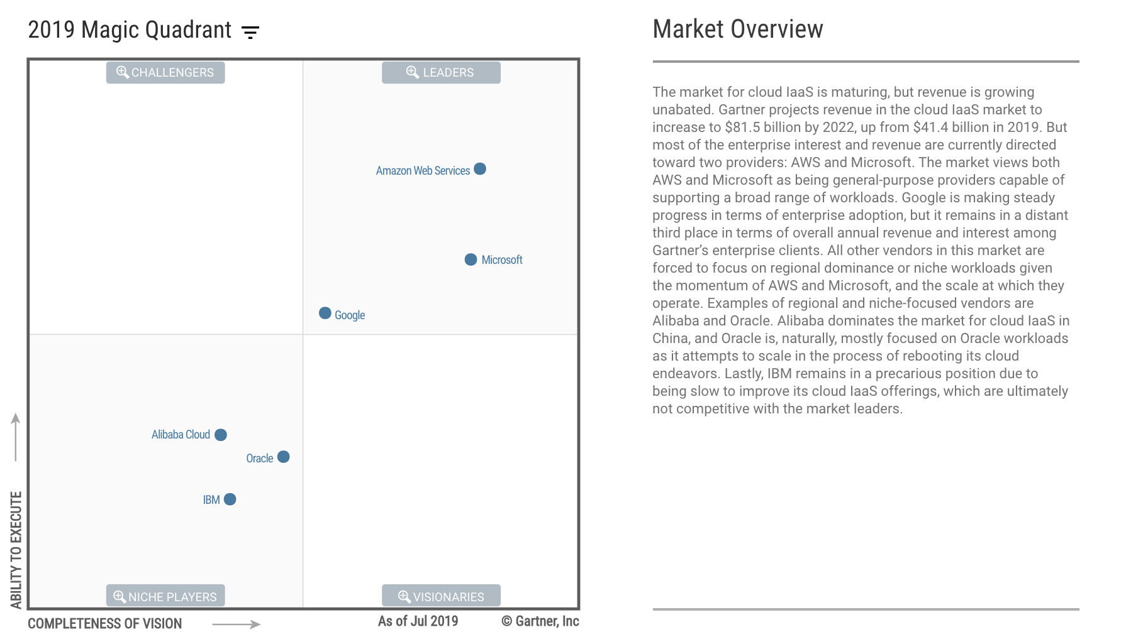
What Cloud Platform?

Slide 10
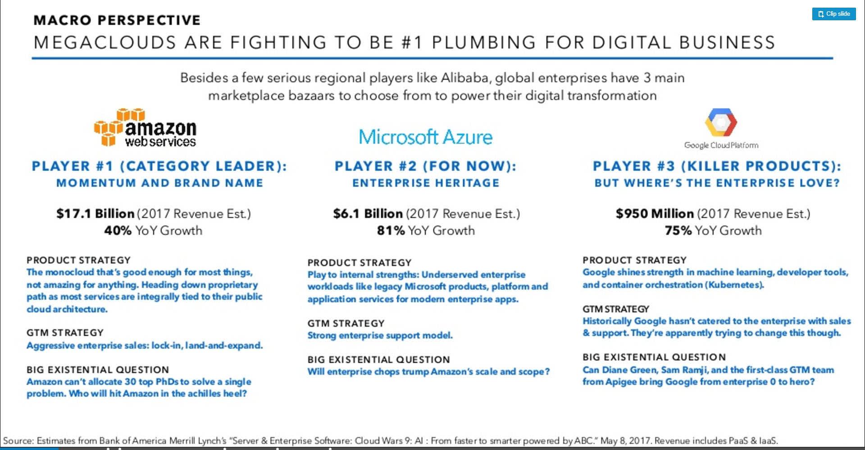

Slide 11
How do I ingest data?
File transfer
Live stream
Sockets
Syslog
Messaging system
From existing databases

Slide 12

Apache Kafka
Source: http://www.slideshare.net/charmalloc/

Slide 13
How do I store data?
HDFS
Cassandra File System
NoSQL database only
Mongo / HBase / Cassandra
Kafka for Kappa Architecture
zFS / GlusterFS / NFS etc

Slide 14
How do I process data?
Simple Map Reduce (Hadoop)
DAG
e.g Spark, SparkR, SQL
Realtime only (Flink, Kafka Streams, Siddhi)
Pipeline
etc

Slide 15
Cluster management systems for Big Data
YARN
Mesos
Spark Master
Kubernetes
Is becoming the defacto standard

Slide 16
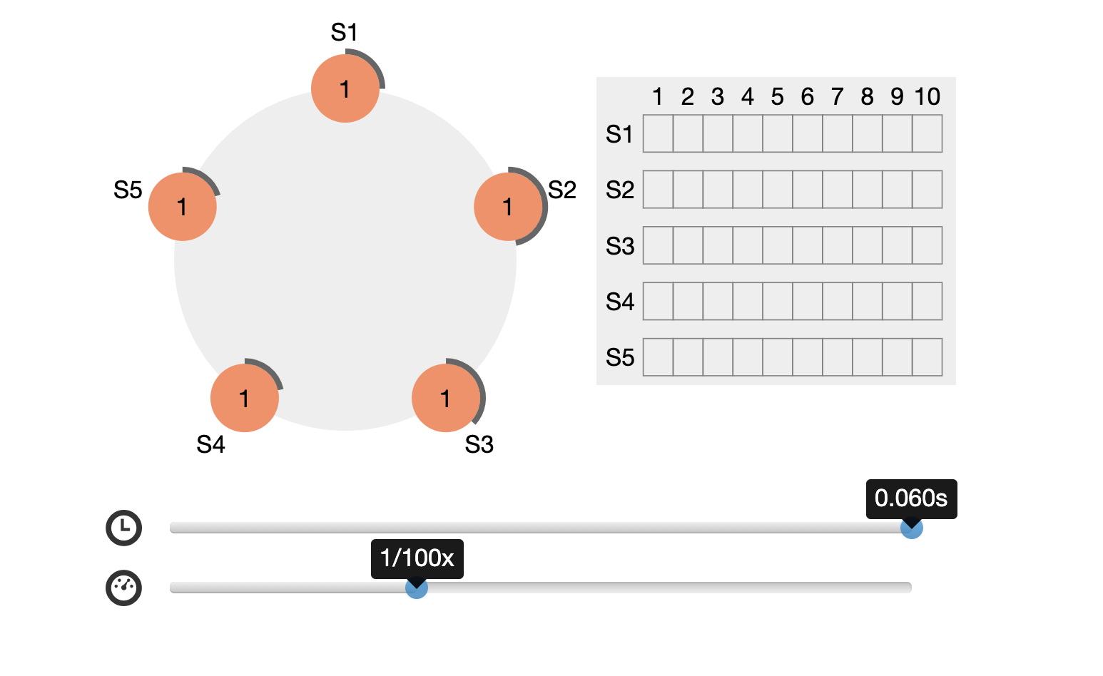
How do I scale up: Consensus

Slide 17

Kubernetes
An operating system for a datacentre
“Processes” are high-available scaled containers running in “Pods”

Slide 18
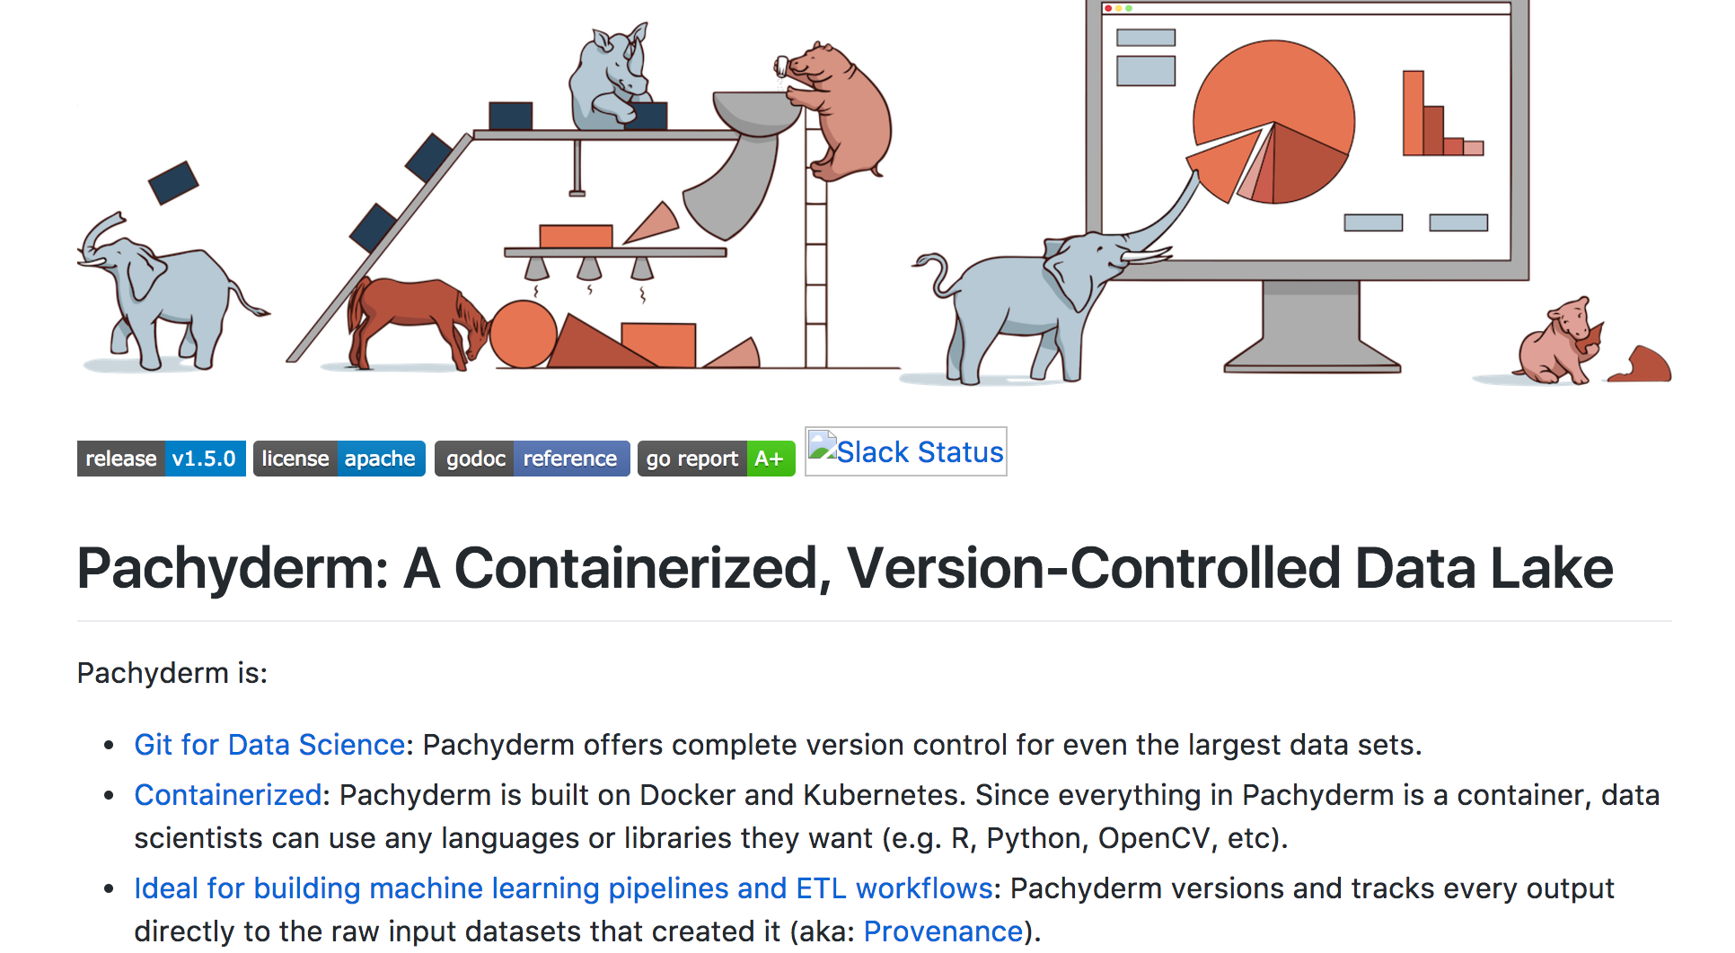
Pachyderm https://github.com/pachyderm/pachyderm

Slide 19
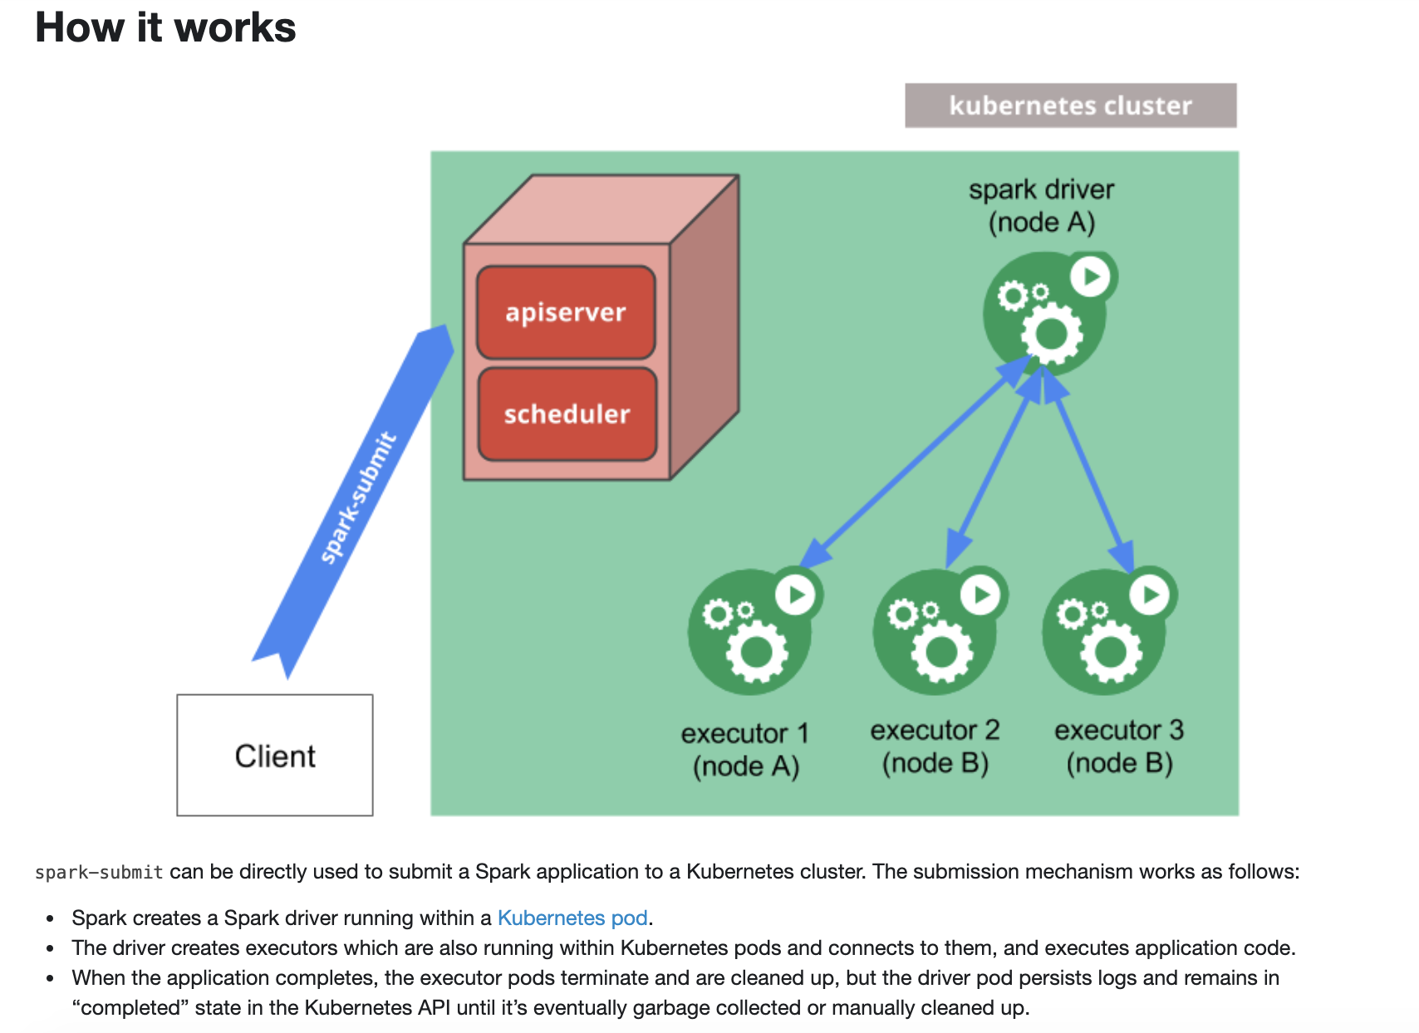
Spark on Kubernetes

Slide 20
Realtime
Apache Storm
Highly flexible model
Supports pure streaming and micro-batch
Lots of plugins
Apache Spark
Micro-batch only
Integrates cleanly into Spark (fewer components)
Some plugins and more being developed

Slide 21
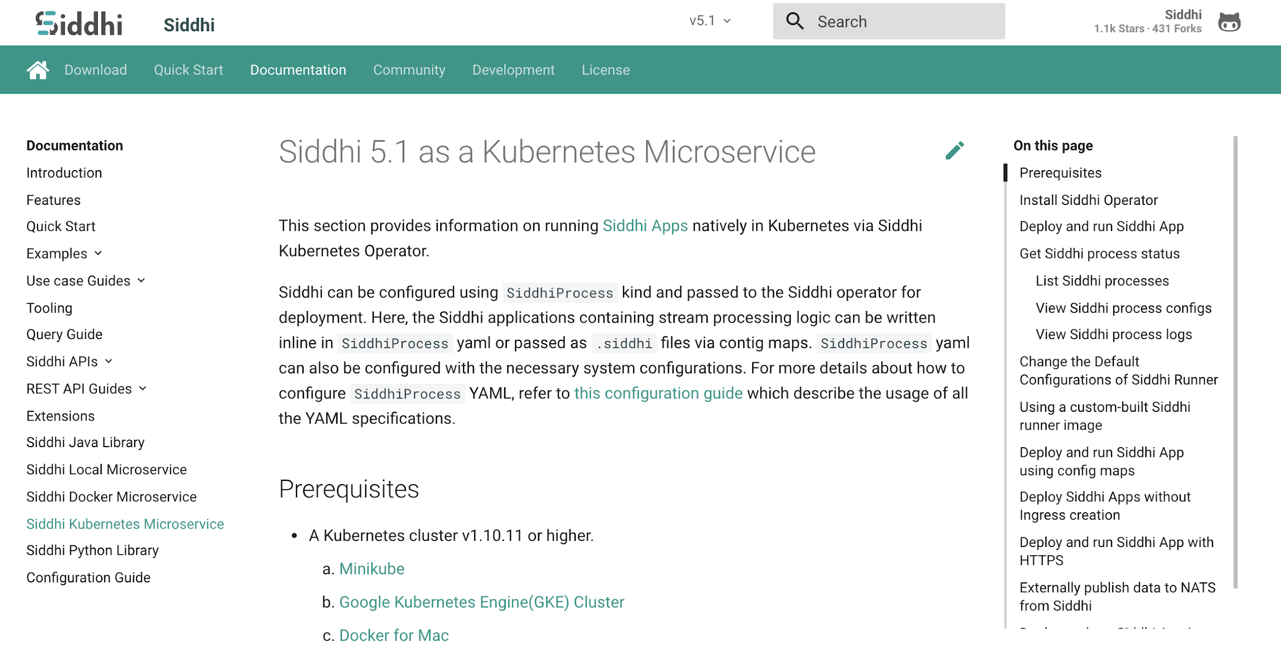
Siddhi on Kubernetes https://siddhi.io/en/v5.1/docs/siddhi-as-a-kubernetes-microservice/

Slide 22
A quick recap on theory
CAP Theorem
PACELC as the “solution”
FLP
Raft and Paxos use random timers as the solution
Scalability at what COST?
Amdahl’s and Gustafson’s
Karp-Flatt Metric

Slide 23
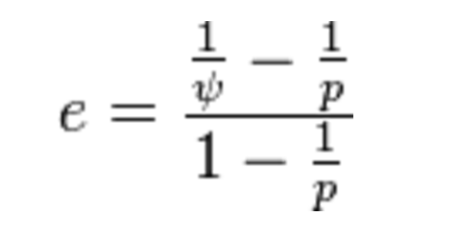
Karp-Flatt Metric
e is the Karp-Flatt Metric
ψ is the speedup
p is the number of processors
e = 0 is the best
e = 1 indicates no speedup
e > 1 indicates adding processors
slows down the system!!!

Slide 24
Fortune top 10 big data companies fortune.com/2014/06/13/these-big-data-companies-are-ones-to-watch/
MapR – Apache Hadoop
MemSQL
Databricks – Apache Spark
Platfora – Apache Hadoop
Splunk
Teradata – Apache Hadoop
Palantir – Hadoop, Cassandra, Lucene
Premise
Datameer – Apache Hadoop
Cloudera – Apache Hadoop
Hortonworks – Apache Hadoop
MongoDB – MongoDB
Trifacta – Apache Hadoop
Rapid Web Application Development with MongoDB and the JVM – Trisha Gee – Tuesday 16:15

Slide 25
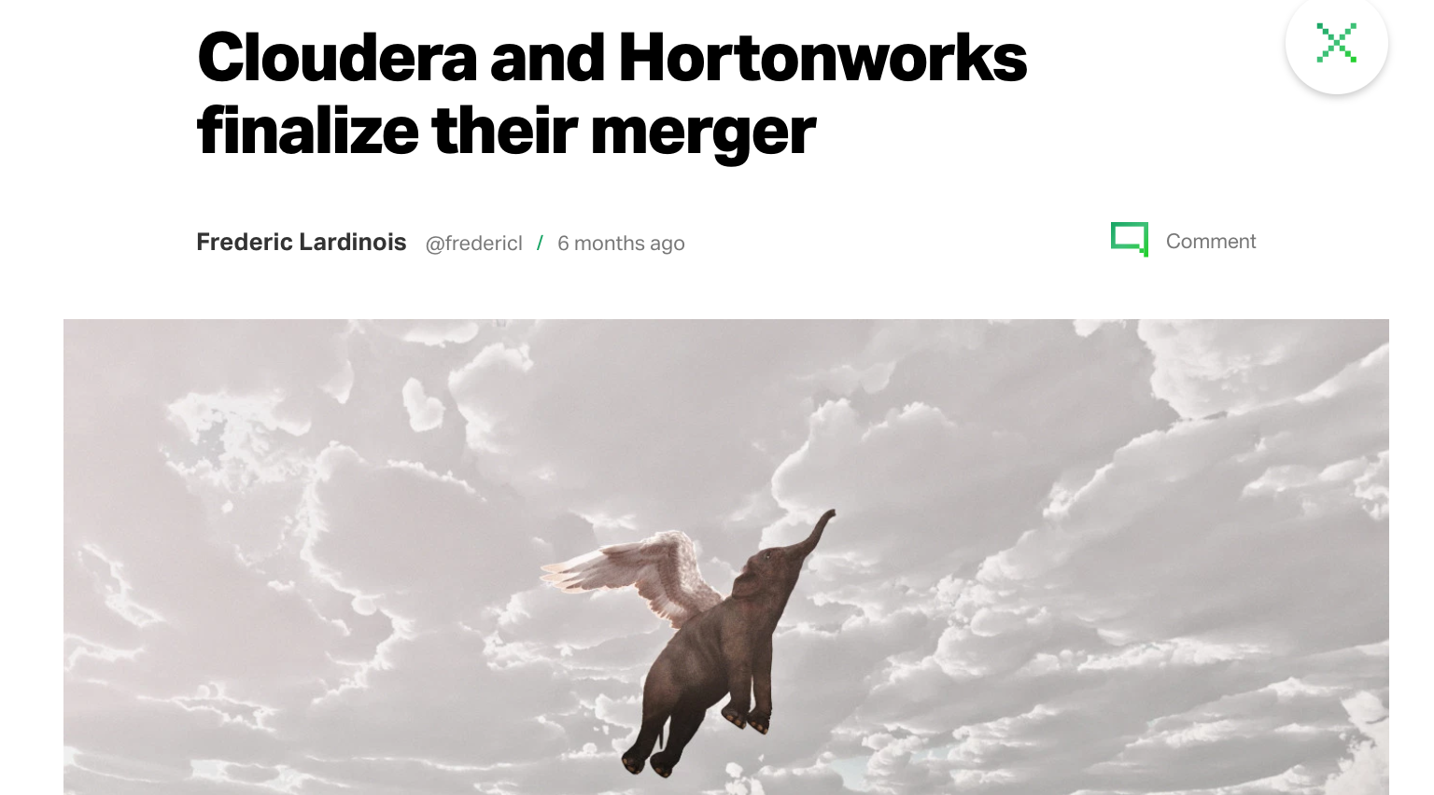
$720m revenue - 2019
Market Capitalization 2021 - ~$4.6bn

Slide 26

Next steps

Slide 27
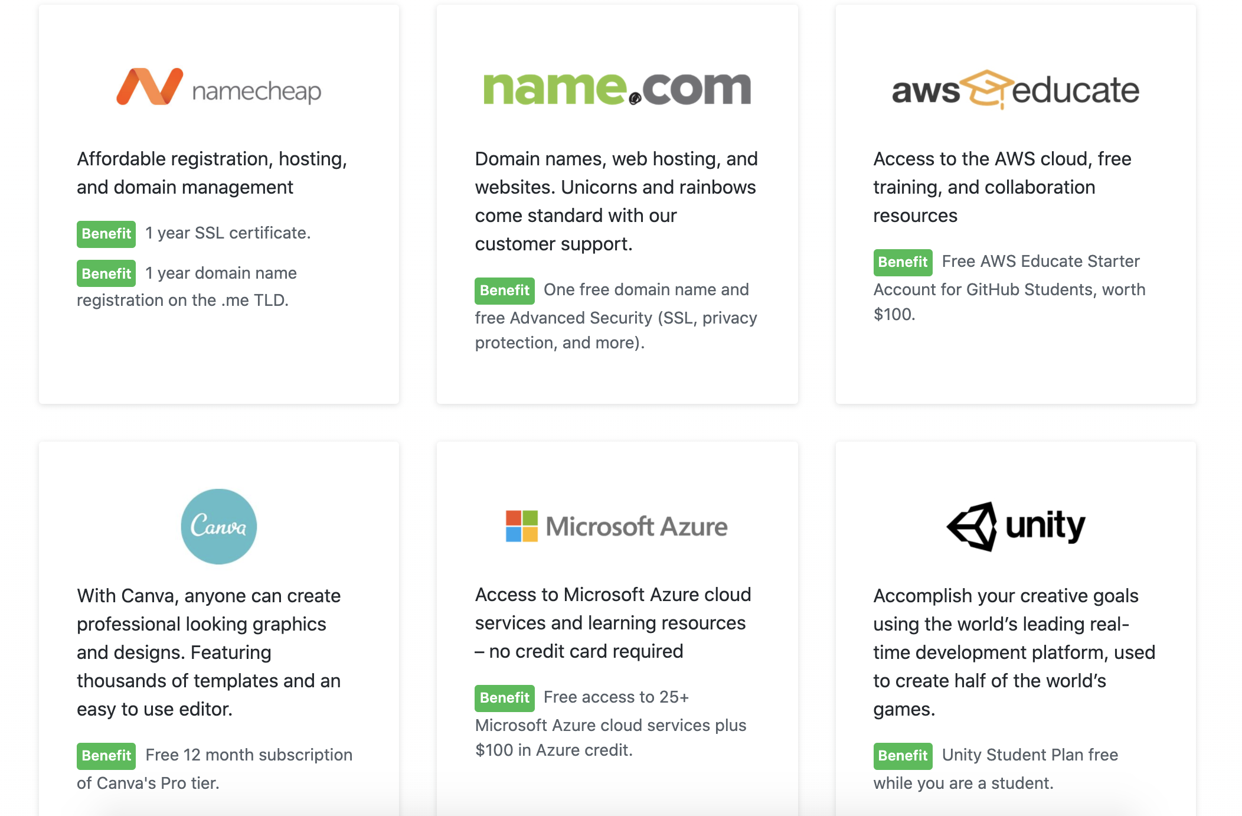
Free stuff

Slide 28
System availability beyond this week
Please sign up with Github Education
See Ex14a
Ex14a and b are done using free DigitalOcean credit
You can use free AWS, Azure or DO credit for the assignment
What will be running and not!
AWS will be removed in the next hour
Kafka TFL until next Friday (Ex13)
Slack running until Monday - please grab anything you need
All the materials for the course are always in Github:
https://github.com/pzfreo/ox-clo

Slide 29
Thanks!
I really appreciate everyone’s hard work and commitment even when remote!
Please fill in the feedback forms
Feel free to add me on LinkedIn https://www.linkedin.com/in/paulfremantle/ But don’t message me until you’ve submitted your assignment!

Slide 30
Questions?

